Slide 1
IMP08 - D365FO On-Prem: A Technical Experience Story
Nathan Clouse
Notes:
Talk about issues, lessons learned, overall headaches and just the experience as a whole

Slide 2
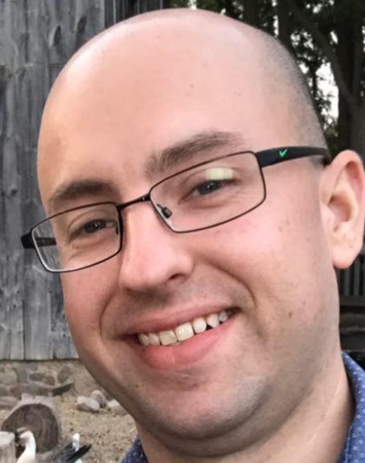


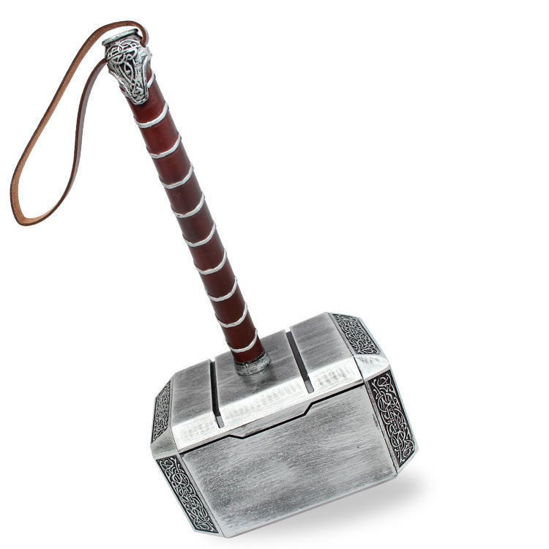
Speaker Blog
Nathan Clouse
Technical Solution Architect
MCA Connect, LLC
AXUG Summit Track Leader
Nathan.clouse@mcaconnect.com
www.atomicax.com
@NathanClouseAX
Notes:
TSA, MCA Connect, blog, twitter
7th summit, 4th summit presenting
9 years with end users, 1 year with MCA

Slide 3
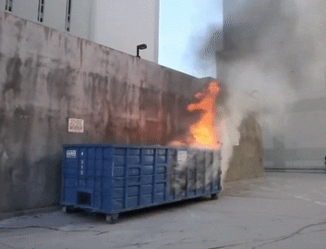
Getting Started…
Notes:
Prizes, make sure you have entered, will be at end
Show of hand: current AX version, 2009, 2012, D365, other
Show of hands: failed LBD implementations? Currently struggling? Just looking? Just want some info before selection?
Want to keep this an informal session so feel free to ask questions at any time

Slide 4
Planning

Slide 5
Have A Plan!
Preparation is key
No plans means lots of headaches and restarts
Keep all documentation up to date – also, document
Consider what it is we are trying to achieve
Lots of moving parts – lots of things to go wrong
Know the actionable before you start
Notes:
4 node? 5 node? 7 node? List out each node, by type with IP/DNS name
Document, document, document – AOS, ORCH, FR, BI nodes, DNA A records, domain and zone, service accounts
SQL, SQL AlwaysOn, SSIS, SSRS, service fabric cluster, ADFS, SMB 3.0 fileshare, encryption, LCS, code packages,
Make a plan, work the plan, checkpoint and waypoint as required

Slide 6
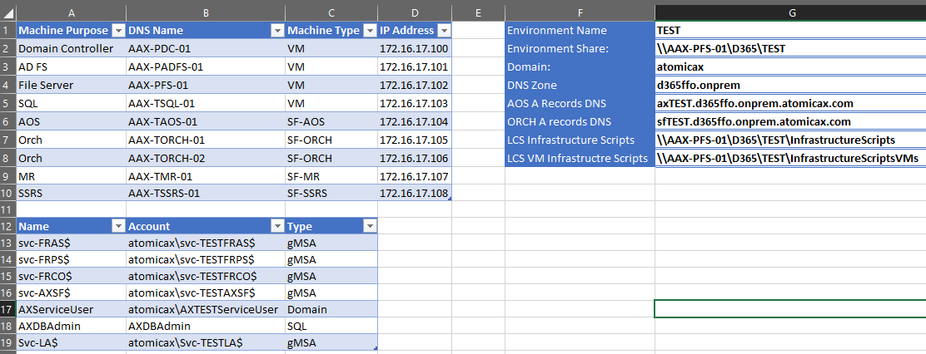
Notes:
4 node? 5 node? 7 node? List out each node, by type with IP/DNS name
Document, document, document,
SQL, SQL AlwaysOn, SSIS, SSRS, service fabric cluster, ADFS, SMB 3.0 fileshare, encryption, LCS, code packages,
Make a plan, work the plan, checkpoint and waypoint as required

Slide 7
Shameless Self Promotion!
IMP09 - D365FO On-Prem: Planning and Building Your On Premise Environments tomorrow morning
Planning tools to review, more in depth review of planning
Thursday: 8:30 AM in 124A - North
Notes:
https://www.eventscribe.com/2018/Summit/fsPopup.asp?Mode=presInfo&PresentationID=423748

Slide 8
Requirements

Slide 9
All The Newest Stuff
Windows 2016
SQL 2016
Misc other software packages that are continuing to change
Azure and LCS still required*
Significant hardware required
Advanced infrastructure a requirement (SANs, VMs, SQL, ADFS, SSIS, SSRS, and so on)
Notes:
https://docs.microsoft.com/en-us/dynamics365/unified-operations/dev-itpro/deployment/setup-deploy-on-premises-pu12
SNAC ODBC, .NET frameworks, SSMS
Need AAD for LCS, LCS is still used for orchestration; LCS handles deployments and overall management of all environments on prem. Azure required for cloud hosted environments

Slide 10
Pre-Execution

Slide 11
Your First and Second deployments will be different
Setup SQL, a file server, and AD FS once per environment type (prod, non-prod)
Separate these out
Checkpoint, checkpoint, checkpoint!
Keep documentation up to date ( also, document )
Use VM Templates for everything ( install common components on template, won’t be used if not needed )
Notes:
https://docs.microsoft.com/en-us/dynamics365/unified-operations/dev-itpro/deployment/setup-deploy-on-premises-pu12
SQL can be shared amongst non-prod instances
SQL will need to be setup again for PROD; same with ADFS
Use VM snapshots regardless of VM type (hyper-v, VMware, whatever else)
In the plan have checkpoints to failback to if something goes wrong
Create a directory for each environment in a share somewhere to storage all scripts, data, configs like XML or JSON and install MSIs and EXEs

Slide 12
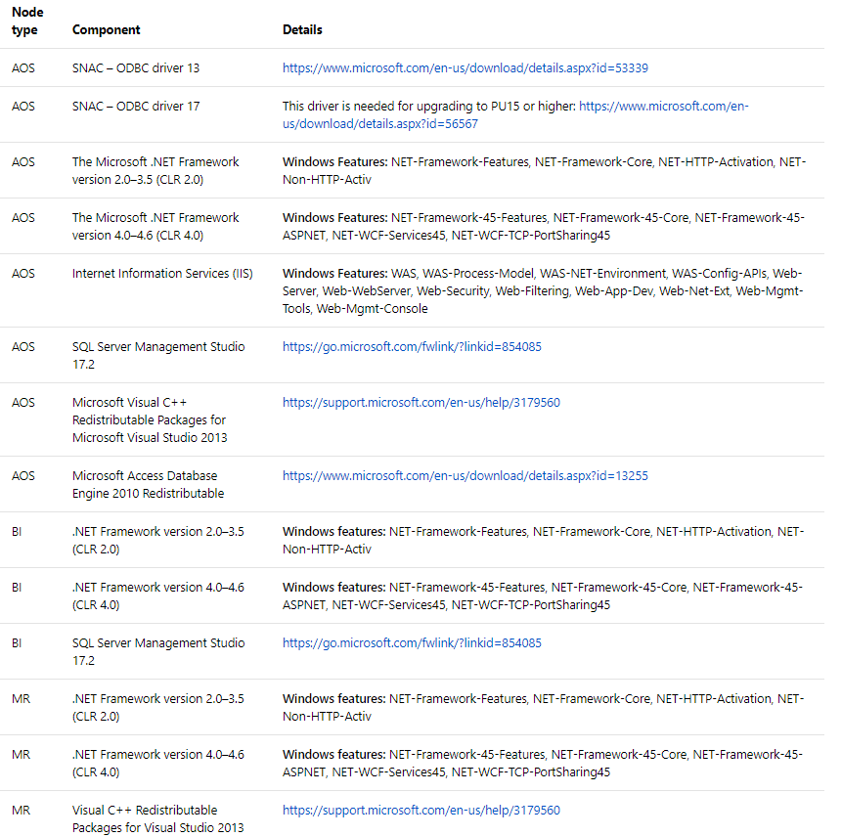

Slide 13
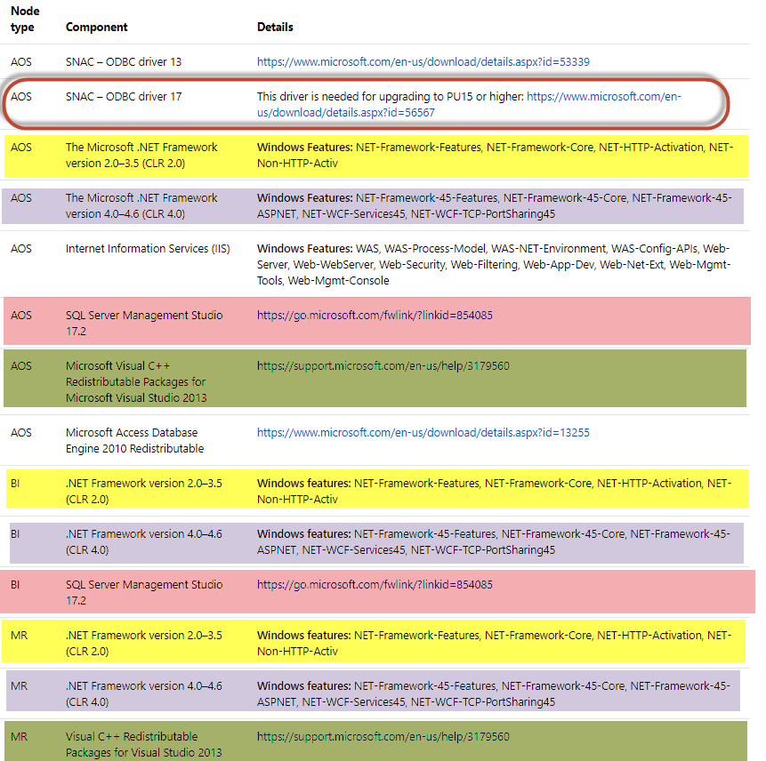

Slide 14
Execution

Slide 15

Take it Slow to Make it So
Read the instructions
Then read the next 10 steps
Then re-read it all again
Backup
Often and completely
Rely on templating with your VM solution to save
time
Notes:
https://docs.microsoft.com/en-us/dynamics365/unified-operations/dev-itpro/deployment/setup-deploy-on-premises-pu12
Show of hands: star trek, star trek the TNG, DS9, voyager

Slide 16

Failures are OK
Use your VM backups
Restore and retry
Still can be somewhat rough even if you’ve done this a few times
Back to Planning
Make the plan, run the plan, update the plan, try again
Notes:
https://docs.microsoft.com/en-us/dynamics365/unified-operations/dev-itpro/deployment/setup-deploy-on-premises-pu12
Structure your activities so you will checkpoints where you can have a fall back point if you run into an issue

Slide 17
Servicing

Slide 18
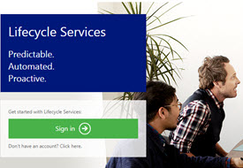
Still using LCS
LCS
Used to deploy packages
Will stage to your environment then you issue final update command (Local Agent 2.1)
7.3 has known issues, skype issues with all
Process
Wipes entire environment from service fabric
Reinstalls it
About an hour of downtime involved
Notes:
https://docs.microsoft.com/en-us/dynamics365/unified-operations/dev-itpro/deployment/setup-deploy-on-premises-pu12
Build can be on prem using the VHD image, upload to LCS, push to environment to update
8.1 coming out soon, no 8.0. Platform Update 15 only supported now for 7.3
Deletes most app, then re-installs them again with the new version.
http://www.atomicax.com/article/lbd-servicing-insights

Slide 19
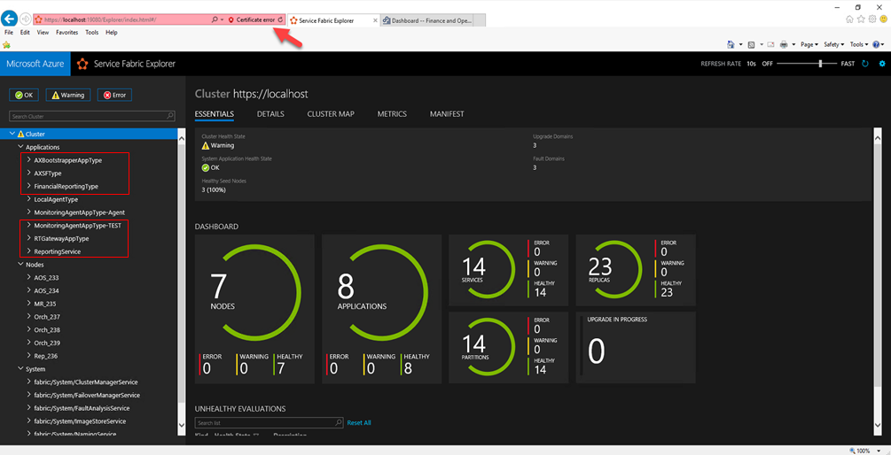

Slide 20
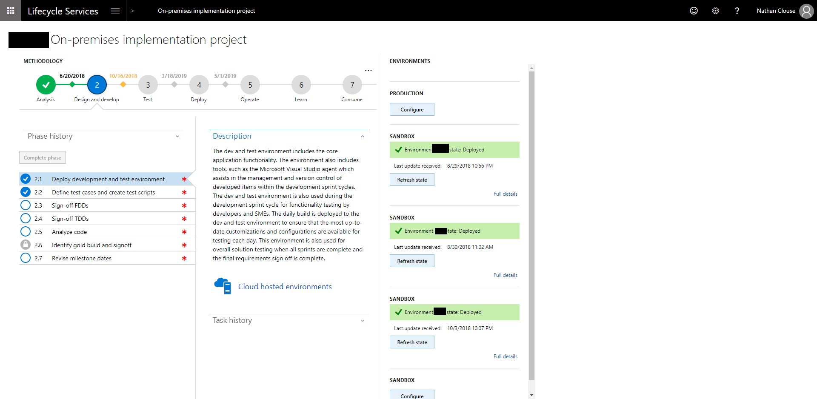

Slide 21
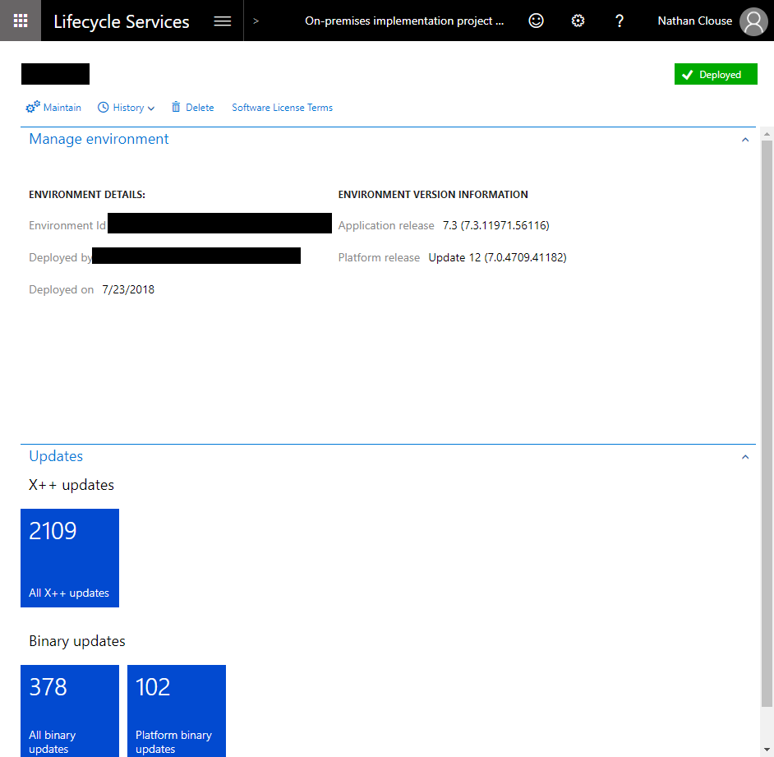
Notes:
https://docs.microsoft.com/en-us/dynamics365/unified-operations/dev-itpro/deployment/setup-deploy-on-premises-pu12
Build can be on prem using the VHD image, upload to LCS, push to environment to update
8.1 coming out soon, no 8.0. Platform Update 15 only supported now for 7.3
Deletes most app, then re-installs them again with the new version.
http://www.atomicax.com/article/lbd-servicing-insights

Slide 22
Other considerations
Cluster
Still requires updates
Have had issues with certificate ACLs
Windows
Windows also needs updates
Don’t use group policy
Notes:
https://docs.microsoft.com/en-us/dynamics365/unified-operations/dev-itpro/deployment/setup-deploy-on-premises-pu12
Fabric has new version every 3 months, support goes for 6 months for major release; Plan on a few upgrades

Slide 23
Misc

Slide 24
Other Rants and Ravings
Security
Certificates can be a pain, select wisely
Requires local, domain and global admin to run process from start to finish
Complexity
Still not a great experience
Lots of areas for failure, little feedback before critical failure that requires reset
Little documentation, little help (but getting better)
Notes:
Self Signed: Not Trusted, have to verify each time or add to safe sites in IE / GPO. Easy to create
AD CS – good in domain, not sure about cross domain like site1.com and site2.com, additional setup required, outside vendors usage?
Issues – globally trusted, from known issuer, slight cost

Slide 25

End Result….

Slide 26
Questions?
……. Also, free stuff.

Slide 27
Please Fill Out Surveys!
We want to hear what you think even if you think I’m terrible but want to be polite about it.

